Slide 1
3. Binding Condition
Three conditions rule out the overgenerated interpretations in (15).
(16) Binding Condition:
(A) An anaphor must be bound in its governing category, if it has one.
(B) A pronominal NP must be free in its governing category if it has one.
(C) A lexical NP must be free everywhere
(15) (a) *John2 hurt himself3 → violates Binding Condition (A)
(b) *John2 hurt him2 → violates Binding Condition (B)
(c) *John2 hurt Fred2 → violates Binding Condition (C)

Slide 2
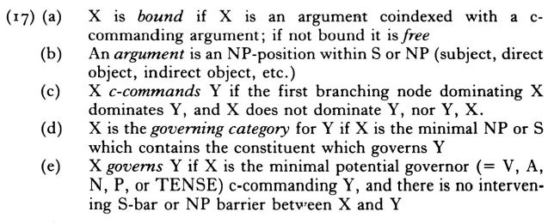
To understand (16), we need the following definitions:

Slide 3
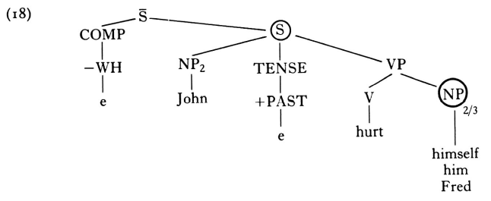
The tree structure of (15):
governing category
governor governee
The encircled NP in (18) is governed by the verb hurt. The minimal S or NP-node containing the verb
hurt is the encircled S-node; hence the encircled S-node is the governing category for the encircled NP.
If the encircled NP-position is filled by the reflexive anaphor himself, then condition (16) (A) specifies
that himself must have a c-commanding coindexed antecedent NP within the encircled S. The NP John
c-commands the encircled NP, since the first branching node above John is the S-node, and the S-node
dominates the encircled NP. Thus if himself is coindexed with John as in John2 hurt himself2, then
the resultant structure satisfies the Binding Condition (16) (A).

Slide 4
(20) *John2 hurt himself3 violates Binding Condition (16) (A)
(21) (a) *John2 hurt him2 violates Binding Condition (16) (B)
(b) John2 hurt him3/4
(22) (a) *John2 hurt Fred2 violates Binding Condition (16) (C)
(b) John2 hurt Fred3/4
(20) : himself isn’t bound in its governing category since it is differently indexed from John.
(21)(b) and (22)(b) are satisfying Binding Condition (16)(b) and (16)(C) respectively.
- (21)(b) : him is free in its governing category since it is differently indexed from the antecedent John.
- (22)(b) : lexical NP Fred is free since it is differently indexed from the antecedent John
◈ Result
Governor(case를 부여하는 요소)와 governee(case를 받는 NP)를 포함한 minimal governing category인
NP 또는 S내에서 anaphor는 bound되어야 하며 pronominal, lexical NP는 free하여야 Binding Condition을
준수한다.

