Slide 1
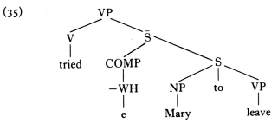
6. Additional barrier S-bar to government
barrier
(34) *John tried Mary to leave
We may assume that the verb tried
actually governs the NP Mary, and
hence may assign objective case to
Mary. But Mary cannot get objective
case.
Mary needs a nominative case since it is a subject in the subordinate clause.
And clearly, tried cannot govern Mary because of the intervening S-bar, which is a barrier.
(36)
S-bar is an absolute barrier to government (i.e. no category can govern
Another category across an intervening S-bar)

Slide 2
Mary receives no case at all. Here, if we propose the following Case Filter then we have a principled
account of the ill-formedness of the sentence (34).
- (34) is ill-formed because it contains an overt NP Mary which has no case, so that the sentence
falls foul of condition (38).
- When there is no barriers to government with case-assigning, the government can be established.
The Barrier Condition (39) can be directly incorporated into our earlier definition of governs.

Slide 3
7. Assignment of Nominative Case
A nominative case is assigned to an NP which is the subject of its clause.
This clause has two types: tensed (=finite) and untensed (=infinitival, nonfinite).
Tensed clauses contain a Tense constituent with AUX like will, would, can, could, shall, should, etc.,
whereas untensed clauses contain the infinitive marker to.
The read-clause in (40) is
tensed.
The read-clause in (41) is
untensed.

Slide 4
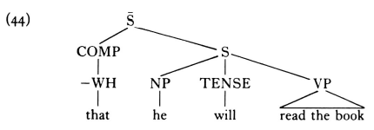
(43)
The TENSE auxiliary will actually governs the subject NP he. Government may play a key role not only
in objective case-marking, but also in nominative case-marking as well. So we can formulate the
relevant rule like (45):
(45) NP is assigned the case-feature [+NOMINATIVE] if governed by TENSE.
We have to allow not only lexical categories (V, P, N, A), but also TENSE to be a governing node.
NP is marked nominative if the subject of a tensed S
(i.e. an S containing a TENSE auxiliary)

Slide 5
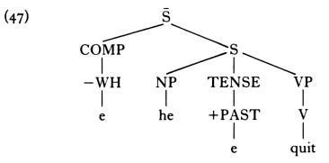
Additional structure of (44) : CP
COMP TP
that NP T’
he T VP
[-past] V NP
will read the book
# Let’s see a tensed sentence which contains no overt tense-marking auxiliary like will :
(46) He quit The subject NP he is governed by TENSE.
TENSE can give a nominative case to he.

