Slide 1
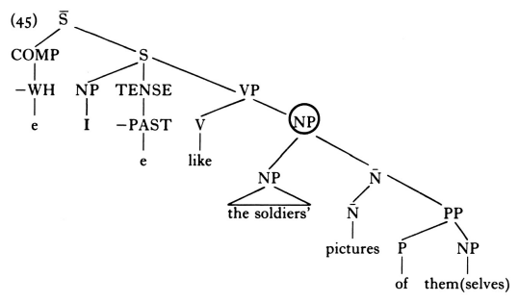
5. A minimal governing category can be NP
I like [NP the soldiers’ pictures of them/themselves]
governing category
(a) I like the soldiers’3 pictures of themselves3 -> satisfies Binding Condition (A)
(b) I like the soldiers’3 pictures of them4 -> satisfies Binding Condition (B)
*I like the soldiers’3 pictures of them3 -> violates Binding Condition (B)

Slide 2
(50) The soldiers like her picture of them/themselves
(51) *The soldiers2 like [NP her3 picture of themselves2 ]
(52) The soldiers2 like [NP her3 picture of them2 ]
S
NP VP minimal governing category
The soldiers2 V NP
like NP N’
her3 N PP
picture P NP
of themselves2
them2

Slide 3
6. Can empty NPs serve as antecedents?
Can traces be antecedents for anaphors?
(1) John2 seems [S t2 to have hurt himself2 ]
governing category
The anaphor himself is governed by the verb hurt,
and the minimal governing category containing the
governor and the governee is S.
Binding Condition (A) requires that it has a coindexed
c-commanding antecedent within the governing
category S. Here, the trace c-commands himself and
occurs within S, so the trace serves as the antecedent
for himself.
As a result, John seems to have hurt himself
satisfies Binding Condition (A).

Slide 4
(2) Who2 [S t2 might hurt himself2 ] -> satisfies BC (A)
(3) John2 wants [S PRO2 to better himself2 ] -> satisfies BC(A)
S’
COMP S gorverning category
[+WH] NP T VP
Who2 t2 might V NP
hurt himself2

